Slide 1
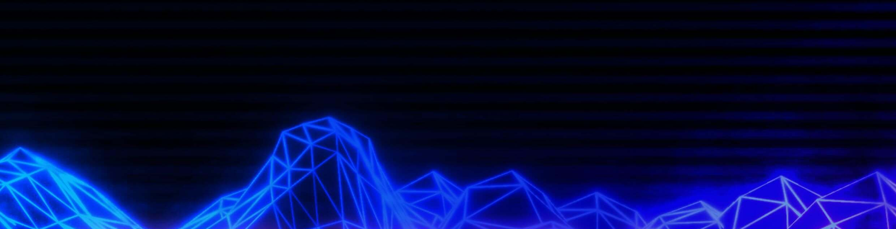

building a shell from scratch

Slide 2
Redbrick AGM
Wednesday 3rd April - CG05.
Chair
Vice-Chair
Secretary
Public Relations Officer
Treasurer
Graphical Design Officer
Events Officer x2
Ordinary Member x2
System Administrator x3
Webmaster
Helpdesk x2

Slide 3
today’s material
Code → github.com/theycallmemac/sesh
Slides → jamesmcdermott.ie/sesh

Slide 4
what is a shell?
Interface (kernel metaphor)
Interpreter (like python3 interpreter)
Environment (it’s surroundings describe it and its functionality)
Tool (and that means it’s replaceable)

Slide 5
why do we use shells?
Simple (or at least as simple as interacting with your machines resources can be)
Fast (Yeah GUI is nice, but it’s much faster to operate through a shell)

Slide 6
how do they work?
Read (they interpret the user input)
Tokenize (they split the input into arguments)
Execute (they execute these arguments)
Let’s look at a simple example in Python

Slide 7
types of shells
fish
ksh
csh
sh
zsh
tcsh
bash

Slide 8
am I qualified?
Yes
… and No
Cheap plug: I wrote a shell called ezsh
Check it out at ezsh.jamesmcdermott.ie

Slide 9
today’s workshop
6 Sessions
5 writing code
1 asking questions
Reflection

Slide 10
simple
easy
shell

Slide 11
simple
easy
shell

Slide 12
session one
Mocking a basic shell
Read
Write
Execute

Slide 13
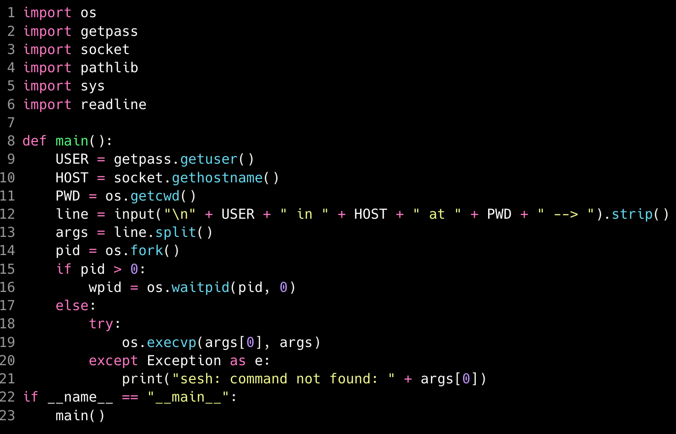

Slide 14
session two
Looping
Modularisation

Slide 15
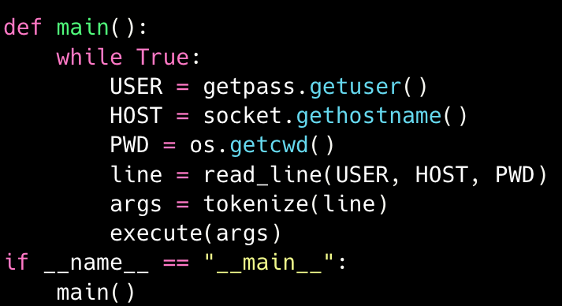

Slide 16
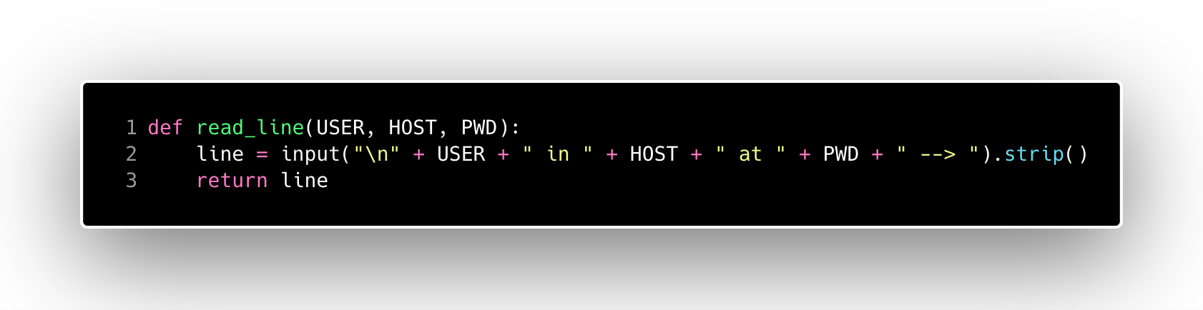
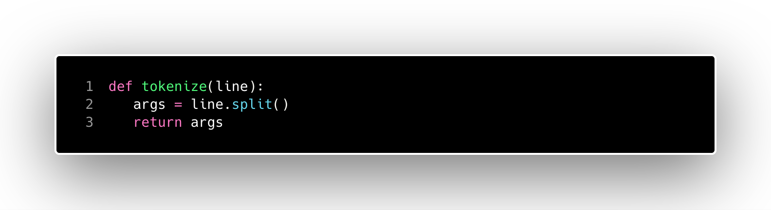
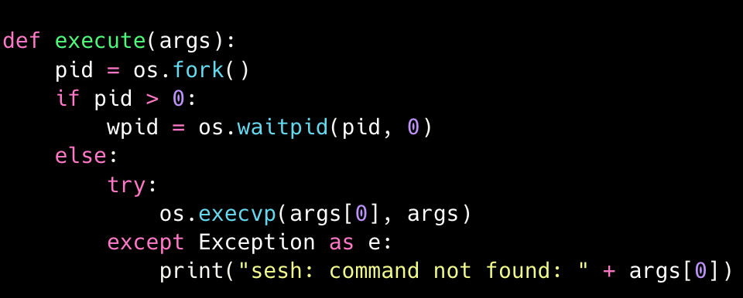

Slide 17
session three
Making Built In Commands
cd
quit
Launch and Execute Functions

Slide 18
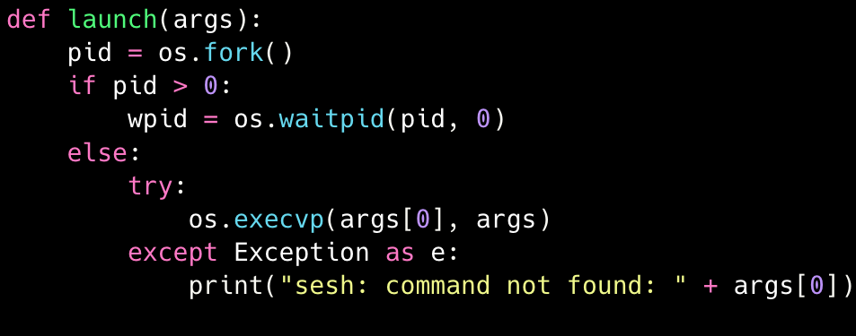
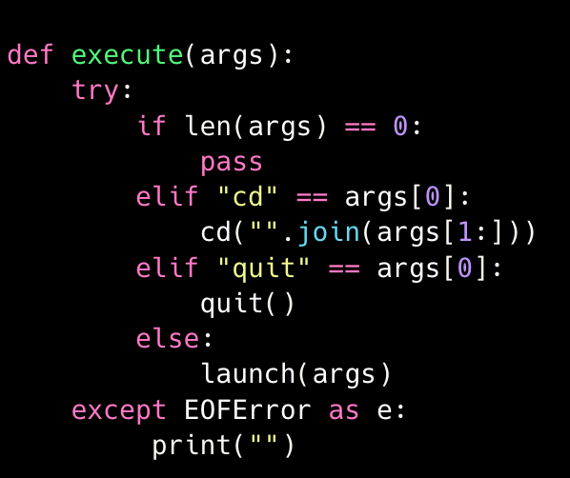

Slide 19
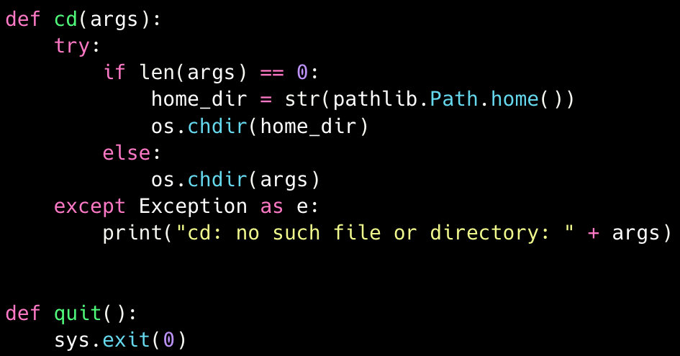

Slide 20
session four
Let’s make it colourful
Autocompletion

Slide 21
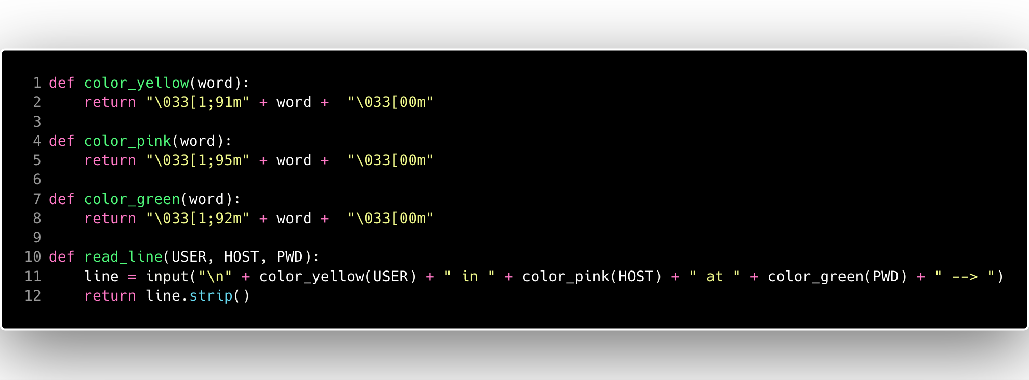

Slide 22
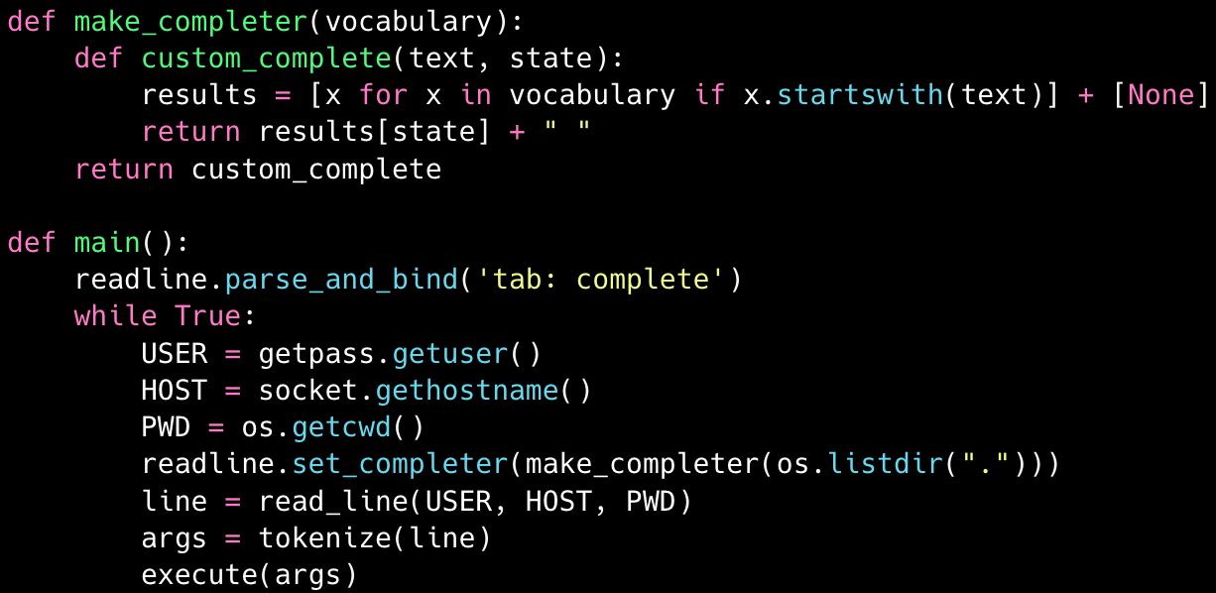

Slide 23
session five
sesh interpreter

Slide 24
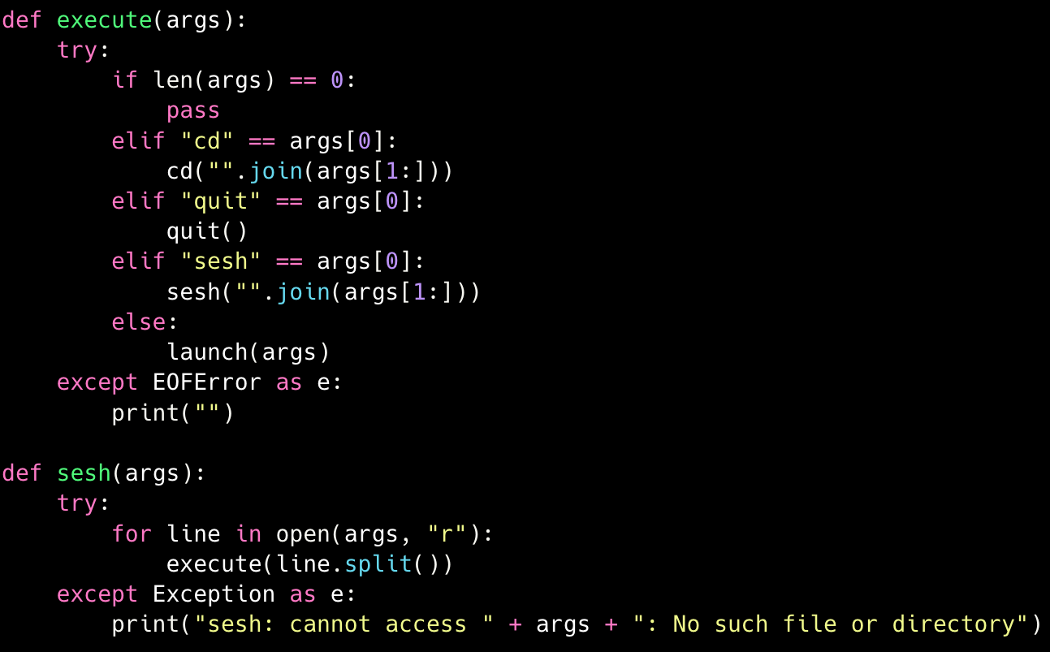

Slide 25
session six
chat and question time:
i/o redirection
pipes
logical operations
background processes
other built in commands
questions?

Slide 26
today’s material
Code → github.com/theycallmemac/sesh
Slides → jamesmcdermott.ie/sesh

